Slide 1
Arrays
Introduction to Programming with C

Slide 2
Simple Arrays (1D Array)
A list of items can be given one variable name using only one subscript and such a variable is called a single scripted variable or a one-dimensional array.
Example: If we want to represent a set of five numbers, say (35,40,20,57,10), by an array variable , then we may create the variable number as follows:
int number[5]; //static memory allocation
The computer reserves five consecutive locations to store values.

Slide 3
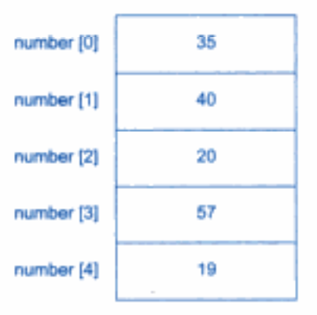
Values Stored

Slide 4
Evaluate the Context
aNumber = number[0] + 10
number[4]=number[0] + number[2];
number[2] = x[5] + y[10];
value[6] = number[ i ] * 3; eg i =3

Slide 5
Creating an array:
int a[5];
float list[10];
char name[25]; [to store names or work with strings]
int a[5],b[5], total[15];
char name[20], surname[20], address[50];
float principal[10],rate[10], interest[10];
int a[10] = { 1,2,3,4,5,6,7,8,9,10 }; //dynamic initialization
char name[8] = {“Aashish”};
is same as char name[8]= {‘A’,’a’,’s’,’h’,’i’,’s’,’h’,’\0’};

Slide 6
Evaluate the code:
int main() {
int x[10]; for(int i=1; i<=10; i++) { x[i-1]=i; }
}

Slide 7
Programming Exercise
Write a program to read 10 numbers from the user. Your program should find the arithmetic mean.

Slide 8
Programming Exercise
Write a program to read 10 numbers from user as input. Your program should check for each number, whether it is even or odd. Your program should display the final count of even and odd numbers at the end.

Slide 9
Programming Exercise
Write a program to read 10 numbers from the user. Your program should find the largest number from the set of user input data and display it to the user.

Slide 10
Programming Exercise
Write a program to read 10 numbers from the user. Can you write the logic to find out the largest and the smallest number from the given data set. (Implementing it with a single loop?)

Slide 11
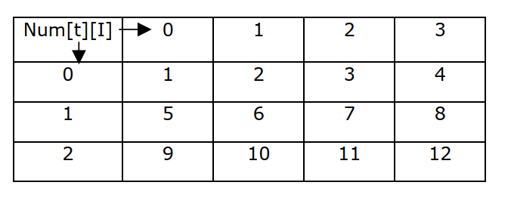
2D Arrays

Slide 12
Result Processing Problem
Roll No | Math | Science | Nepali
18001 | 52 | 55 | 65
18002 | 72 | 75 | 85
18003 | 21 | 41 | 22
18004 | 99 | 98 | 91

Slide 13
Creating a 2D array:
int a[5][5];
float list[10][10];
char name[25][40];
int a[5][5], total[5][5];
char name[20], surname[20], address[50];
int matrixa[3][3], matrixb[3][3], matrixc[3][3];

Slide 14
Self Research
Ways to define 2 D array. Search about different methods and learn about different tricks.

Slide 15
Evaluate the Code
for (int i=0; i<5; i++) { for(int j=0; j<5; j++) { if(i==j) myArray[i][j]=1; else myArray[i][j]=0; } }

Slide 16
Programming Exercise
Write a program to perform matrix addition. Your program should be able to add two 3 X 3 Martix.

Slide 17
Programming Exercise
Write a program to perform matrix subtraction. Your program should be able to subtract two 2 X 3 Martix.

Slide 18
Programming Exercise
Write a program to calculate the transpose of a 4 X 4 matrix. Your program should read the matrix value from the user, calculate its transpose and display it to the user.

Slide 19
Strings
A string is a list of characters enclosed by double quotation marks: eg: “hello, this is a string”
It is necessary to declare character array to be one character longer than the largest string that it can hold. eg: to declare an array name that can hold upto 10 characters, we write it as: char name[11];
It is not necessary to manually add the null (‘\0’) onto the end of string variables. The compiler does this automatically.

Slide 20
Simple String Input-Output
int main() { char name[40]; printf(“Enter your name”); gets(name); puts(name); //console i/o printf(“%s”,name); //formatted i/o return 0; }

Slide 21
Array of Strings
To create an array of strings, a two dimensional character array is sued with the size of the left index determining the number of strings and the size of the right index specifying the maximum length of each string.
Eg: To declare an array of 10 names, with each name having max length of 25 characters char name[10][25];

Slide 22
Programming demo of array of strings in the class

Slide 23
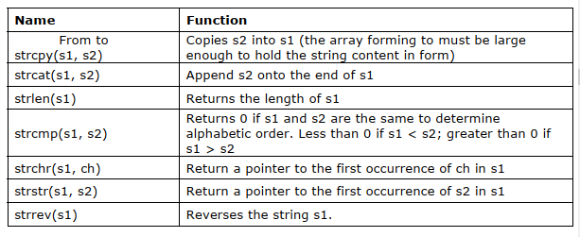
String Handling Function

Slide 24
Programming demo of string handling functions in the class

